Slide 1
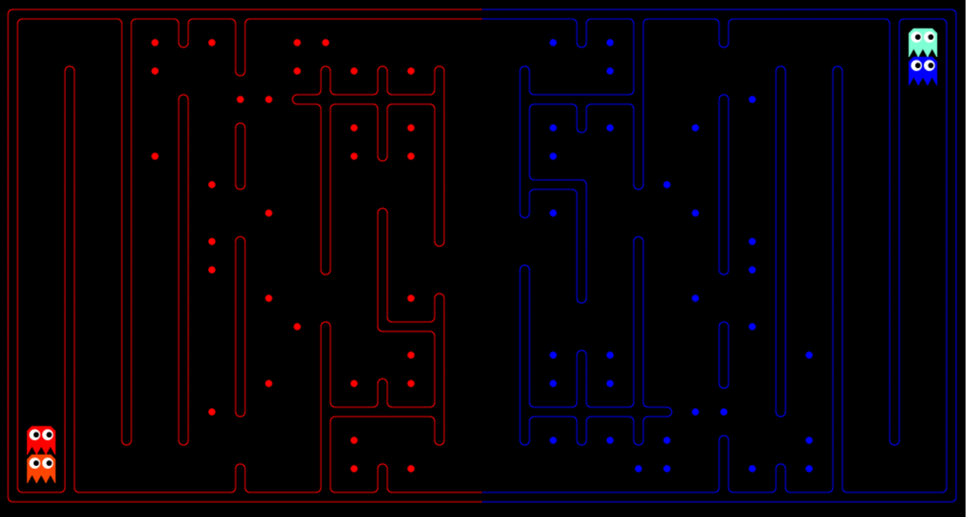
Project 1 Mini-Contest

Slide 2
Fun Names in 11-31
^_^ Alex Sawai
☹){ :|:&};: Craig Hiller and Chris Hsu
noeffort Jason McGhee
AimingForLast Jinyu Oh [15]

Slide 3
Top-10
10 TuPAC Kasey Moffat
9 test111 Boyi Chen
8 ILIKEBIGBOTSANDICANNOTLIE Keonhwa Song and Y. S. Kim
7 lastattempt Roger Shen
6 OK Bot Aaron Zhuo
5 Staff too good ☹ Ton Hon Lai
4 BL (Bots’ Love) Joseph Hui and Alan Yao

Slide 4
Top-3 (in alphabetical order)
Artificially.Retarded Fan Ye and Tianhao Zhang
tooskoolforkool Austin Satterlee
Zephyr Kevin Casey and Zeyu (Andrew) Liu

Slide 5
tooskoolforkool vs Zephyr
https://contest.cs188.org/contest_matches/15510

Slide 6
Artificially.Retarded vs. Zephyr
Fan Ye and Tianhao Zhang
Divide food into groups using k-means select 2 groups that are farthest apart
Pick up other food that is nearby along path to target
Assign scores to food based on distances between both agents, food, and finishing line
When amount of food left is low enough, use search to find optimal path for remaining food
Kevin Casey and Zeyu (Andrew) Liu
Split the food into two groups, one for each agent, using a heavily modified minimum spanning tree
Start with greedy path through food for each agent
Randomly shuffle the path and compare to old path, keeping the new path if it has lower cost

Slide 7
Artificially.Retarded vs. Zephyr
https://contest.cs188.org/contest_matches/17896

Slide 8
Top-10
10 TuPAC Kasey Moffat
9 test111 Boyi Chen
8 ILIKEBIGBOTSANDICANNOTLIE Keonhwa Song and Y. S. Kim
7 lastattempt Roger Shen
6 OK Bot Aaron Zhuo
5 Staff too good ☹ Ton Hon Lai
4 BL (Bots’ Love) Joseph Hui and Alan Yao
3 tooskoolforkool Austen Satterlee
2 Artificially.Retarded Fan Ye and Tianhao Zhang
1 Zephyr Kevin Casey and Zeyu (Andrew) Liu

Slide 9
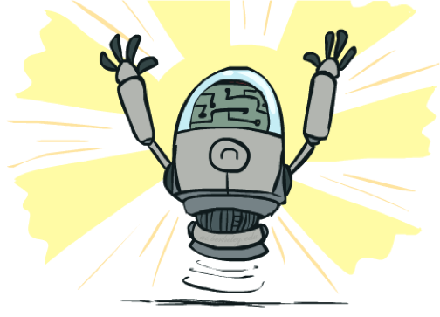
Congratulations!

Slide 10
Project 2 Mini-Contest

Slide 11
Announcements
Homework 3: Games
Has been released, due Monday 2/17 at 11:59pm.
Project 2: Multi-Agent Pacman
About to be released, due Friday 2/21 at 5:00pm.
Optional mini-contest, due Sunday 2/23 at 11:59pm.
Exam conflicts
If you emailed us your conflict by last week Tuesday’s deadline, you should have heard back from us. If somehow not, contact us again!
edX and Pandagrader grade consolidation survey
Due Tuesday 2/18.

Slide 12
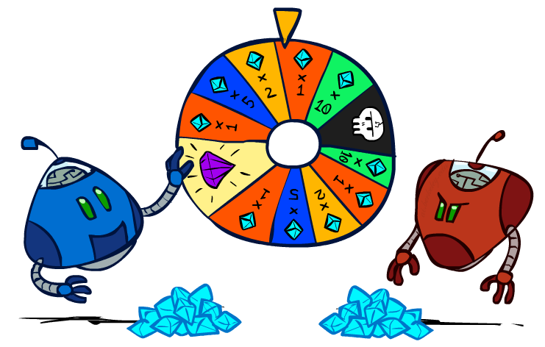
CS 188: Artificial Intelligence
Uncertainty and Utilities
Instructors: Dan Klein and Pieter Abbeel
University of California, Berkeley
[These slides were created by Dan Klein and Pieter Abbeel for CS188 Intro to AI at UC Berkeley. All CS188 materials are available at http://ai.berkeley.edu.]
Notes:
Please retain proper attribution, including the reference to ai.berkeley.edu. Thanks!

Slide 13
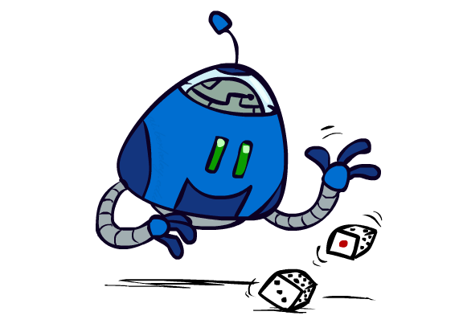
Uncertain Outcomes

Slide 14
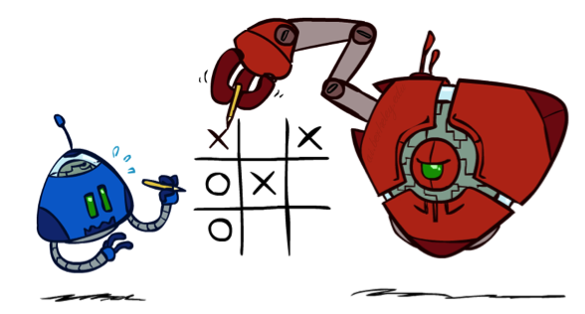

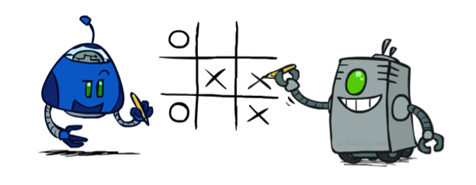
Worst-Case vs. Average Case
max
min
10
10
9
100
Idea: Uncertain outcomes controlled by chance, not an adversary!
Notes:
At least 10, or otherwise just rather dead; or just 100, or otherwise rather dead; that’s yet something different than minimax or expectimax

Slide 15
Expectimax Search
Why wouldn’t we know what the result of an action will be?
Explicit randomness: rolling dice
Unpredictable opponents: the ghosts respond randomly
Actions can fail: when moving a robot, wheels might slip
Values should now reflect average-case (expectimax) outcomes, not worst-case (minimax) outcomes
Expectimax search: compute the average score under optimal play
Max nodes as in minimax search
Chance nodes are like min nodes but the outcome is uncertain
Calculate their expected utilities
I.e. take weighted average (expectation) of children
Later, we’ll learn how to formalize the underlying uncertain-result problems as Markov Decision Processes
max
chance
10
10
4
10
5
9
7
100
[Demo: min vs exp (L7D1,2)]

Slide 16

Video of Demo Minimax vs Expectimax (Min)

Slide 17
Video of Demo Minimax vs Expectimax (Exp)

Slide 18
Expectimax Pseudocode
def value(state):
if the state is a terminal state: return the state’s utility
if the next agent is MAX: return max-value(state)
if the next agent is EXP: return exp-value(state)
def max-value(state):
initialize v = -∞
for each successor of state:
v = max(v, value(successor))
return v
def exp-value(state):
initialize v = 0
for each successor of state:
p = probability(successor)
v += p * value(successor)
return v
Notes:
Pick an order for two reasons: sequential processor and pruning

Slide 19
Expectimax Pseudocode
def exp-value(state):
initialize v = 0
for each successor of state:
p = probability(successor)
v += p * value(successor)
return v
1/2
1/6
1/3
5
8
7
24
-12
v = (1/2) (8) + (1/3) (24) + (1/6) (-12) = 10

Slide 20
Expectimax Example
3
12
9
2
4
6
15
6
0

Slide 21
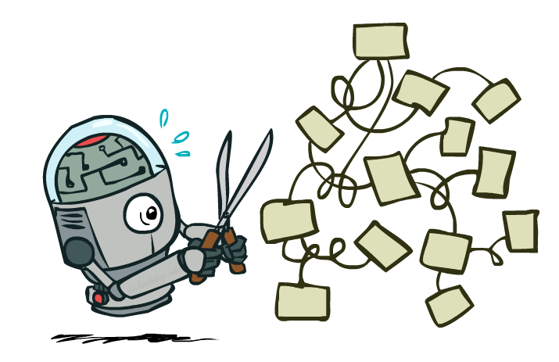
Expectimax Pruning?
3
12
9
2

Slide 22



Depth-Limited Expectimax
Estimate of true expectimax value (which would require a lot of work to compute)
400
300
…
…
492
362
…

Slide 23
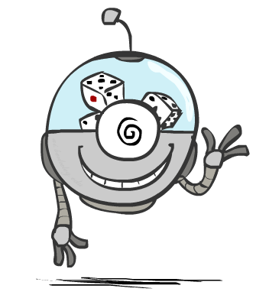
Probabilities

Slide 24
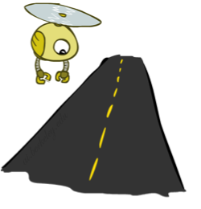
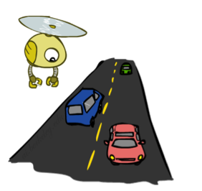
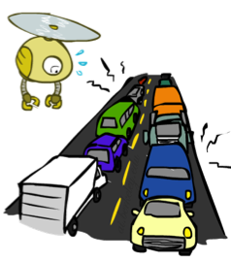
Reminder: Probabilities
A random variable represents an event whose outcome is unknown
A probability distribution is an assignment of weights to outcomes
Example: Traffic on freeway
Random variable: T = whether there’s traffic
Outcomes: T in {none, light, heavy}
Distribution: P(T=none) = 0.25, P(T=light) = 0.50, P(T=heavy) = 0.25
Some laws of probability (more later):
Probabilities are always non-negative
Probabilities over all possible outcomes sum to one
As we get more evidence, probabilities may change:
P(T=heavy) = 0.25, P(T=heavy | Hour=8am) = 0.60
We’ll talk about methods for reasoning and updating probabilities later
0.25
0.50
0.25

Slide 25
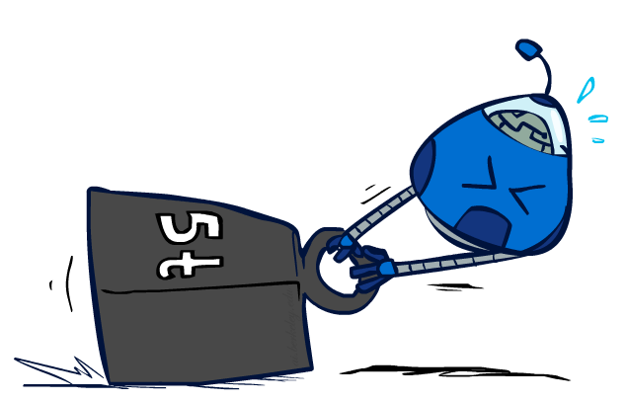
Reminder: Expectations
The expected value of a function of a random variable is the average, weighted by the probability distribution over outcomes
Example: How long to get to the airport?
Time:
20 min
30 min
60 min
+
+
35 min
x
x
x
Probability:
0.25
0.50
0.25

Slide 26

What Probabilities to Use?
In expectimax search, we have a probabilistic model of how the opponent (or environment) will behave in any state
Model could be a simple uniform distribution (roll a die)
Model could be sophisticated and require a great deal of computation
We have a chance node for any outcome out of our control: opponent or environment
The model might say that adversarial actions are likely!
For now, assume each chance node magically comes along with probabilities that specify the distribution over its outcomes
Having a probabilistic belief about another agent’s action does not mean that the agent is flipping any coins!

Slide 27
Quiz: Informed Probabilities
Let’s say you know that your opponent is actually running a depth 2 minimax, using the result 80% of the time, and moving randomly otherwise
Question: What tree search should you use?
Answer: Expectimax!
To figure out EACH chance node’s probabilities, you have to run a simulation of your opponent
This kind of thing gets very slow very quickly
Even worse if you have to simulate your opponent simulating you…
… except for minimax, which has the nice property that it all collapses into one game tree
0.1 0.9

Slide 28

Modeling Assumptions

Slide 29
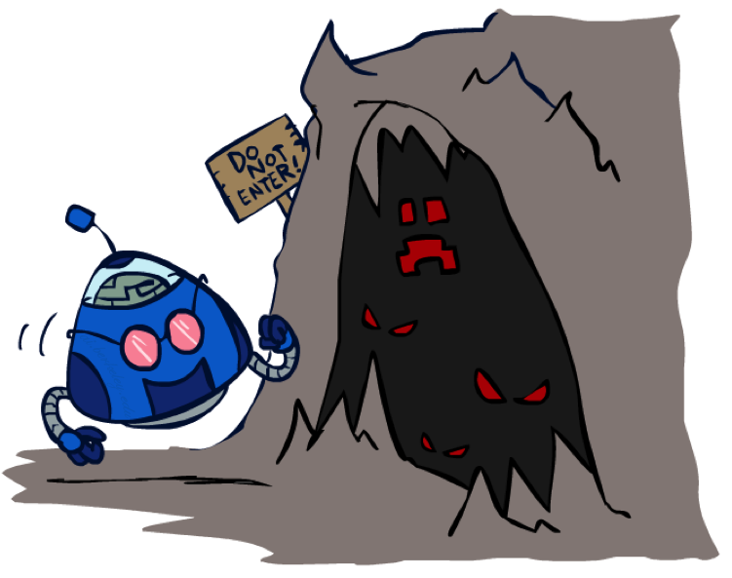
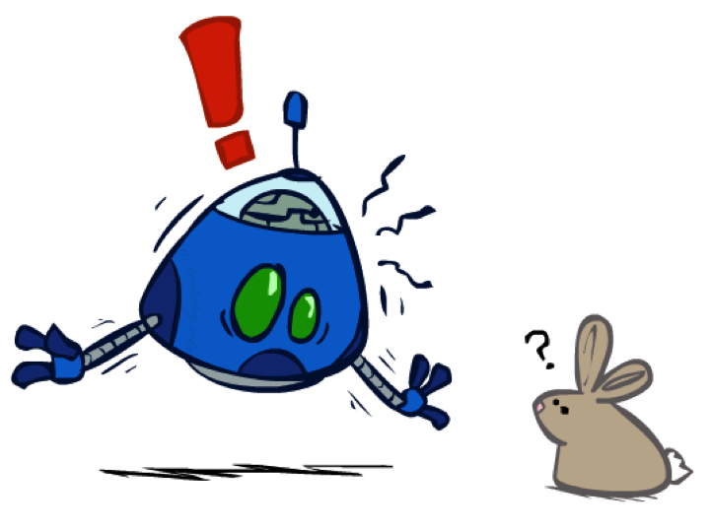
The Dangers of Optimism and Pessimism
Dangerous Optimism
Assuming chance when the world is adversarial
Dangerous Pessimism
Assuming the worst case when it’s not likely

Slide 30
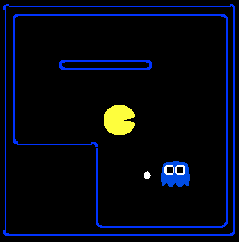
Assumptions vs. Reality
 | Adversarial Ghost | Random Ghost
Minimax Pacman | Won 5/5 Avg. Score: 483 | Won 5/5 Avg. Score: 493
Expectimax Pacman | Won 1/5 Avg. Score: -303 | Won 5/5 Avg. Score: 503
Results from playing 5 games
Pacman used depth 4 search with an eval function that avoids trouble Ghost used depth 2 search with an eval function that seeks Pacman
[Demos: world assumptions (L7D3,4,5,6)]
Notes:
python pacman.py -g SmartGhost -l trapped2 -p ExpectimaxAgent -a depth=4,evalFn=better

Slide 31
Video of Demo World Assumptions Random Ghost – Expectimax Pacman

Slide 32
Video of Demo World Assumptions Adversarial Ghost – Minimax Pacman

Slide 33
Video of Demo World Assumptions Adversarial Ghost – Expectimax Pacman

Slide 34
Video of Demo World Assumptions Random Ghost – Minimax Pacman

Slide 35
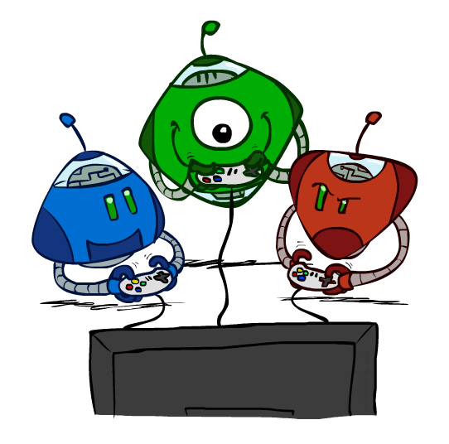
Other Game Types

Slide 36



Mixed Layer Types
E.g. Backgammon
Expectiminimax
Environment is an extra “random agent” player that moves after each min/max agent
Each node computes the appropriate combination of its children
Notes:
If it’s terminal or we reached our depth limit, return utility

Slide 37
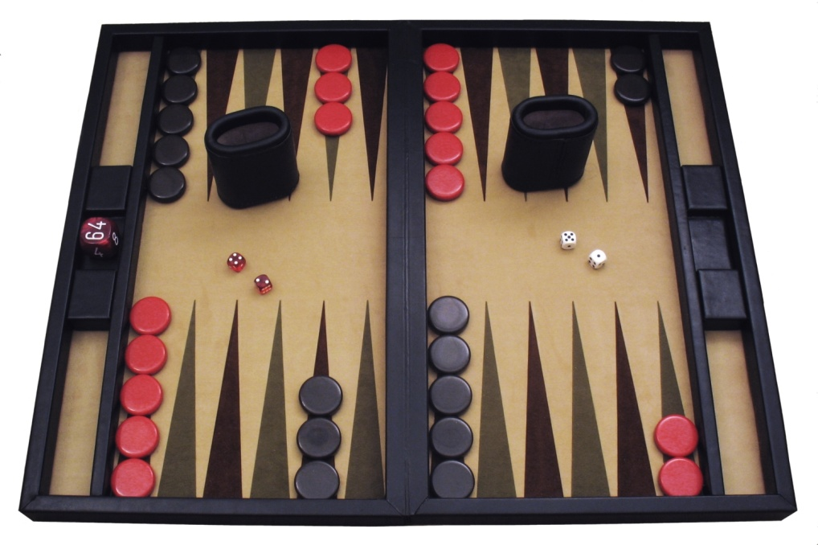
Example: Backgammon
Dice rolls increase b: 21 possible rolls with 2 dice
Backgammon ≈ 20 legal moves
Depth 2 = 20 x (21 x 20)³ = 1.2 x 10⁹
As depth increases, probability of reaching a given search node shrinks
So usefulness of search is diminished
So limiting depth is less damaging
But pruning is trickier…
Historic AI: TDGammon uses depth-2 search + very good evaluation function + reinforcement learning: world-champion level play
1st AI world champion in any game!
Image: Wikipedia

Slide 38
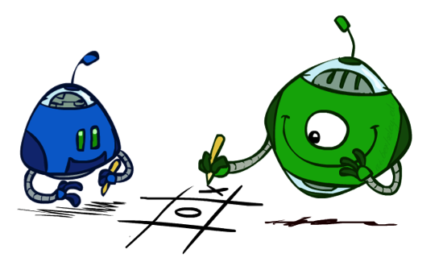
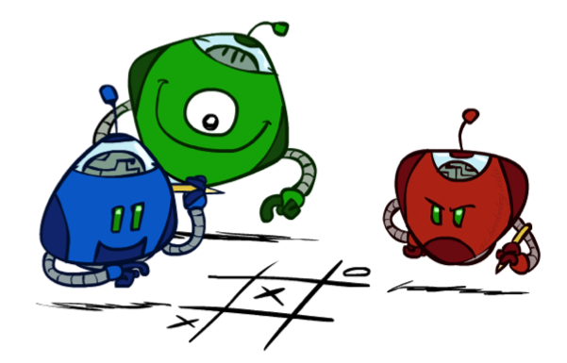
Multi-Agent Utilities
What if the game is not zero-sum, or has multiple players?
Generalization of minimax:
Terminals have utility tuples
Node values are also utility tuples
Each player maximizes its own component
Can give rise to cooperation and
competition dynamically…
1,6,6
7,1,2
6,1,2
7,2,1
5,1,7
1,5,2
7,7,1
5,2,5

Slide 39
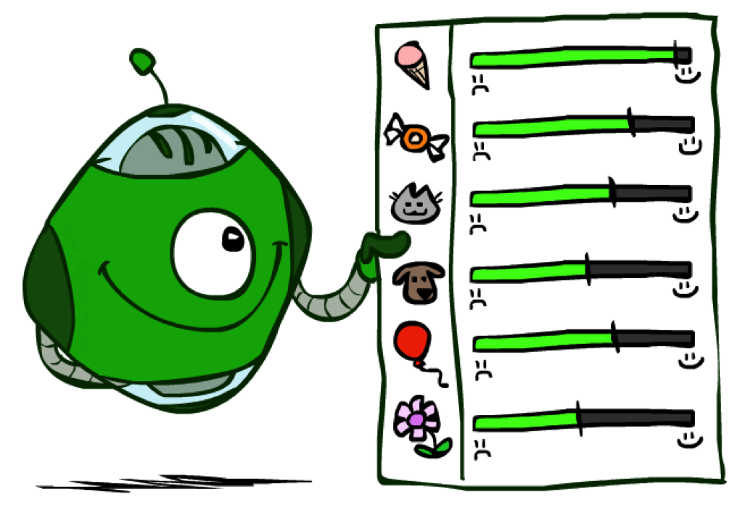
Utilities

Slide 40

Maximum Expected Utility
Why should we average utilities? Why not minimax?
Principle of maximum expected utility:
A rational agent should chose the action that maximizes its expected utility, given its knowledge
Questions:
Where do utilities come from?
How do we know such utilities even exist?
How do we know that averaging even makes sense?
What if our behavior (preferences) can’t be described by utilities?

Slide 41
What Utilities to Use?
0
40
20
30
x²
0
1600
400
900
For worst-case minimax reasoning, terminal function scale doesn’t matter
We just want better states to have higher evaluations (get the ordering right)
We call this insensitivity to monotonic transformations
For average-case expectimax reasoning, we need magnitudes to be meaningful

Slide 42

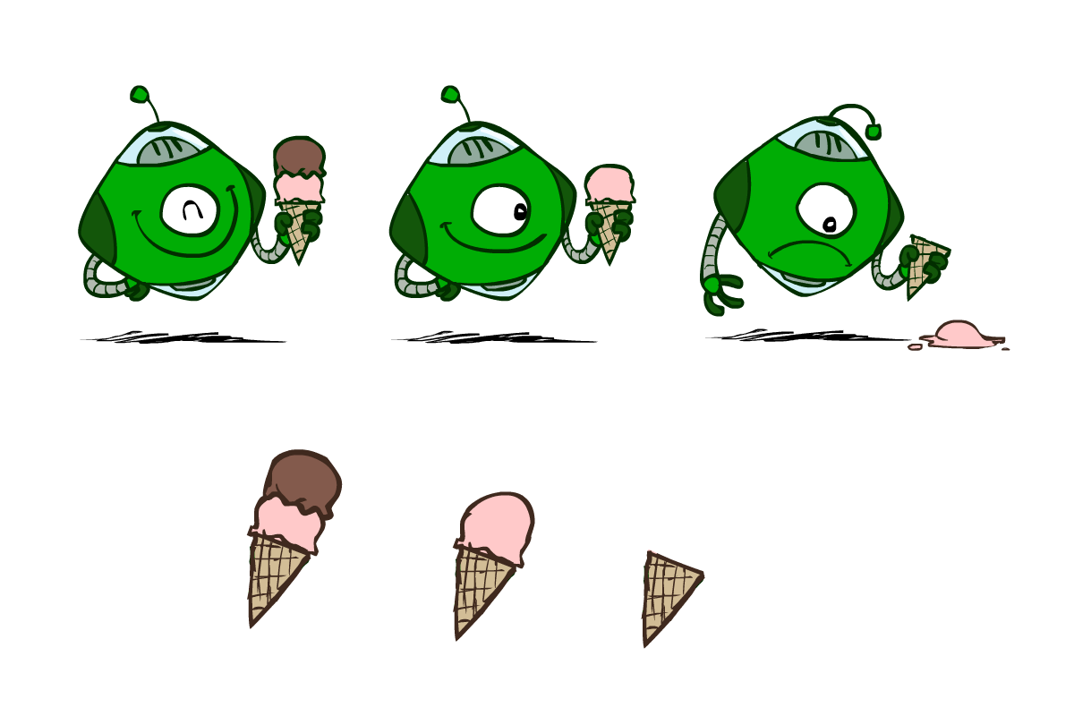
Utilities
Utilities are functions from outcomes (states of the world) to real numbers that describe an agent’s preferences
Where do utilities come from?
In a game, may be simple (+1/-1)
Utilities summarize the agent’s goals
Theorem: any “rational” preferences can be summarized as a utility function
We hard-wire utilities and let behaviors emerge
Why don’t we let agents pick utilities?
Why don’t we prescribe behaviors?

Slide 43
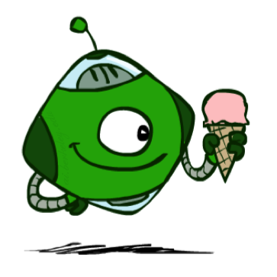
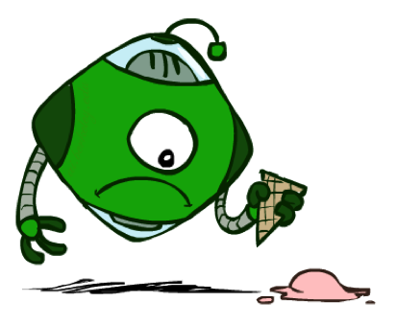
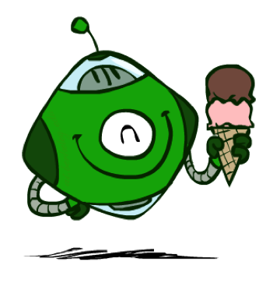
Utilities: Uncertain Outcomes
Getting ice cream
Get Single
Get Double
Oops
Whew!

Slide 44
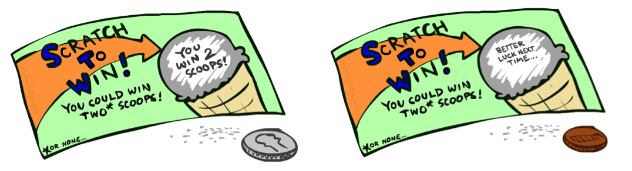
Preferences
A Prize
A Lottery
An agent must have preferences among:
Prizes: A, B, etc.
Lotteries: situations with uncertain prizes
Notation:
Preference:
Indifference:
A
p 1-p
A B

Slide 45
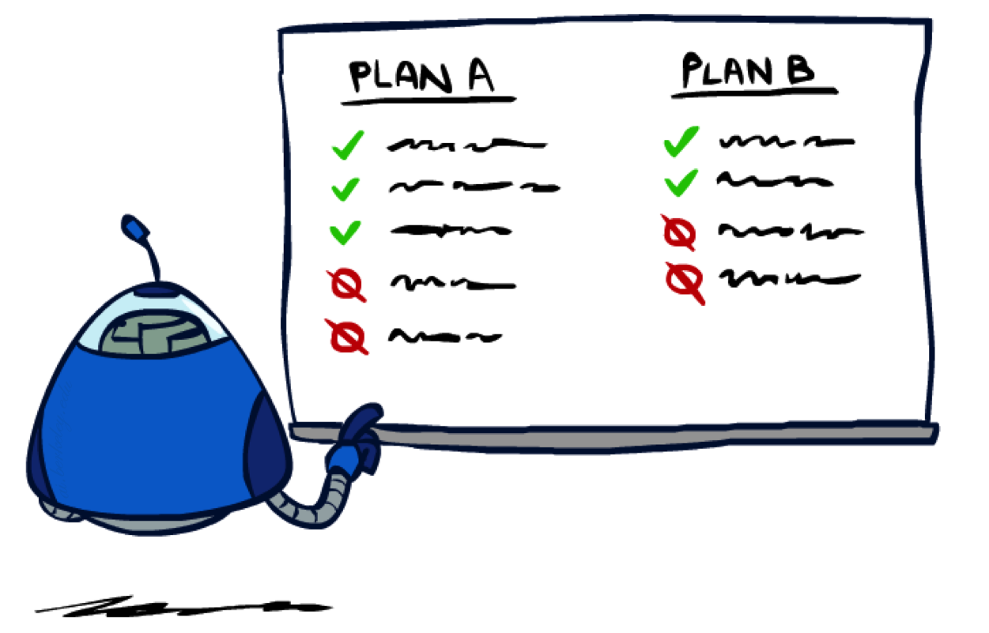
Rationality

Slide 46
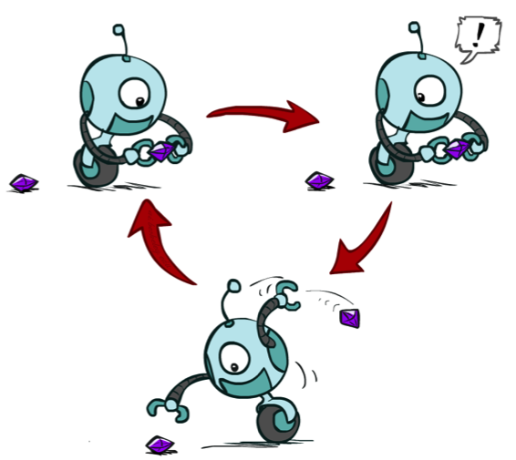
Rational Preferences
We want some constraints on preferences before we call them rational, such as:
For example: an agent with intransitive preferences can
be induced to give away all of its money
If B > C, then an agent with C would pay (say) 1 cent to get B
If A > B, then an agent with B would pay (say) 1 cent to get A
If C > A, then an agent with A would pay (say) 1 cent to get C
Axiom of Transitivity:
Notes:
Apple, banana, carrot

Slide 47

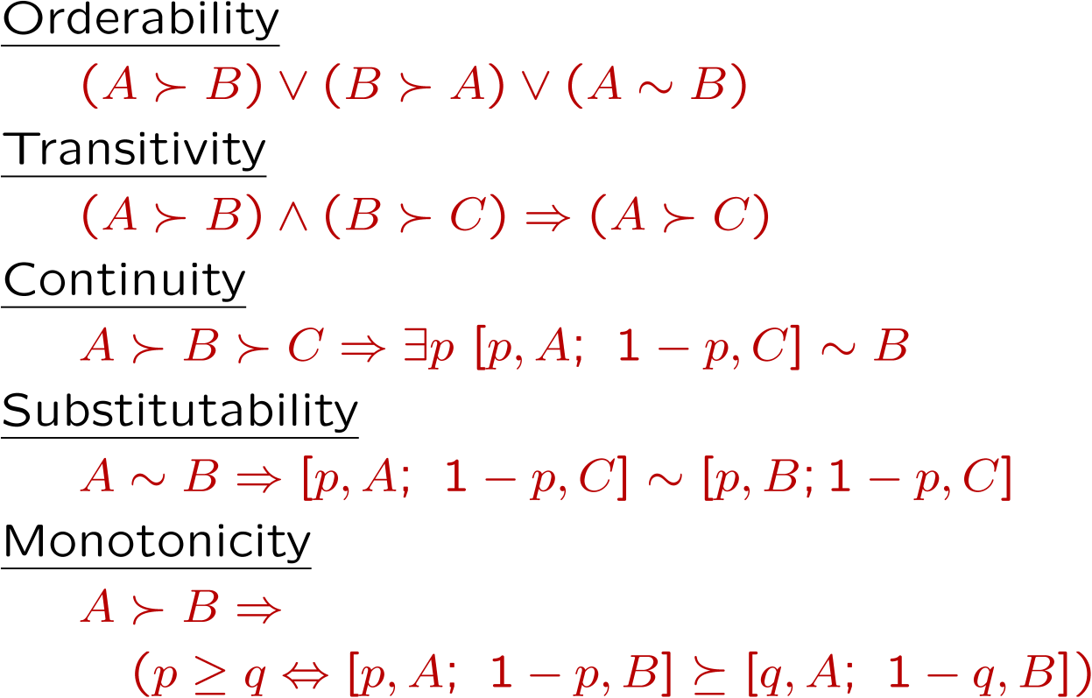
Rational Preferences
The Axioms of Rationality
Theorem: Rational preferences imply behavior describable as maximization of expected utility

Slide 48
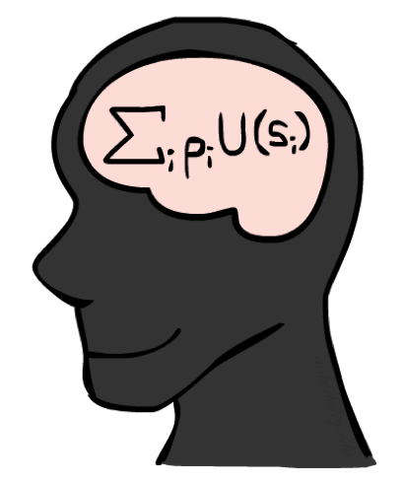
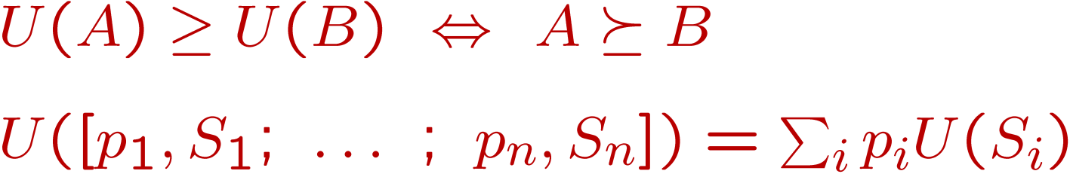
MEU Principle
Theorem [Ramsey, 1931; von Neumann & Morgenstern, 1944]
Given any preferences satisfying these constraints, there exists a real-valued
function U such that:
I.e. values assigned by U preserve preferences of both prizes and lotteries!
Maximum expected utility (MEU) principle:
Choose the action that maximizes expected utility
Note: an agent can be entirely rational (consistent with MEU) without ever representing or manipulating utilities and probabilities
E.g., a lookup table for perfect tic-tac-toe, a reflex vacuum cleaner

Slide 49
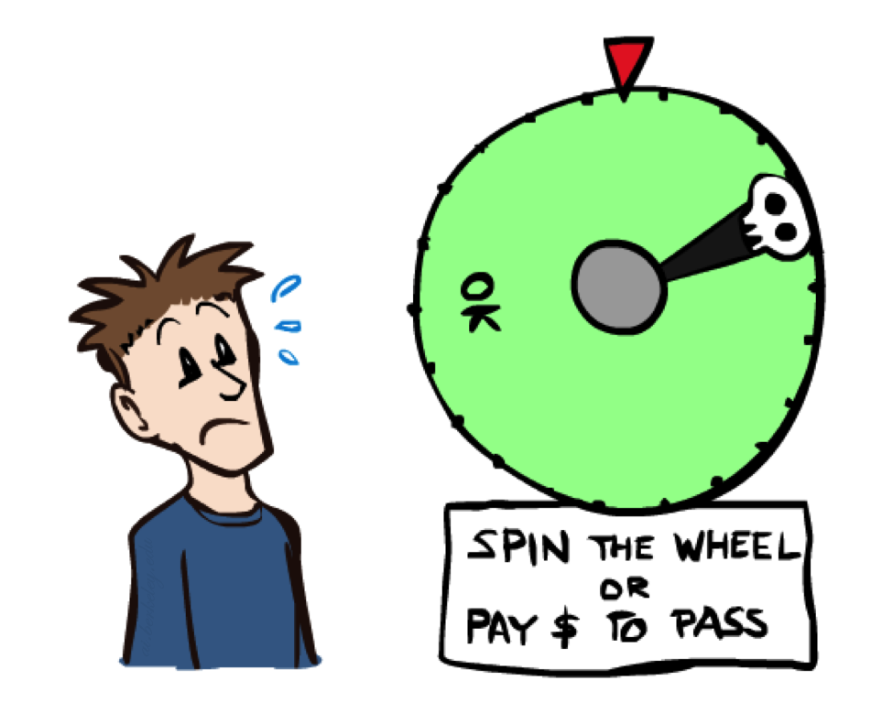
Human Utilities

Slide 50

Utility Scales
Normalized utilities: u₊ = 1.0, u₋ = 0.0
Micromorts: one-millionth chance of death, useful for paying to reduce product risks, etc.
QALYs: quality-adjusted life years, useful for medical decisions involving substantial risk
Note: behavior is invariant under positive linear transformation
With deterministic prizes only (no lottery choices), only ordinal utility can be determined, i.e., total order on prizes

Slide 51


Human Utilities
Utilities map states to real numbers. Which numbers?
Standard approach to assessment (elicitation) of human utilities:
Compare a prize A to a standard lottery L_{p} between
“best possible prize” u₊ with probability p
“worst possible catastrophe” u₋ with probability 1-p
Adjust lottery probability p until indifference: A ~ L_{p}
Resulting p is a utility in [0,1]
Pay $30
0.999999 0.000001
No change
Instant death

Slide 52
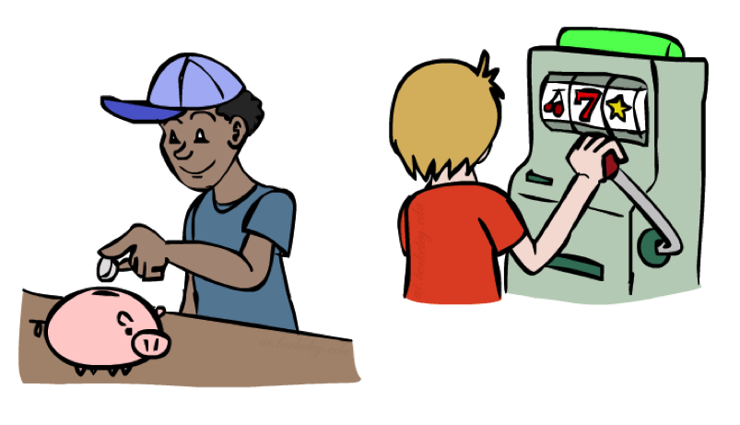
Money
Money does not behave as a utility function, but we can talk about the utility of having money (or being in debt)
Given a lottery L = [p, $X; (1-p), $Y]
The expected monetary value EMV(L) is p*X + (1-p)*Y
U(L) = p*U($X) + (1-p)*U($Y)
Typically, U(L) < U( EMV(L) )
In this sense, people are risk-averse
When deep in debt, people are risk-prone
Notes:
Draw Jensen’s for utility curve

Slide 53
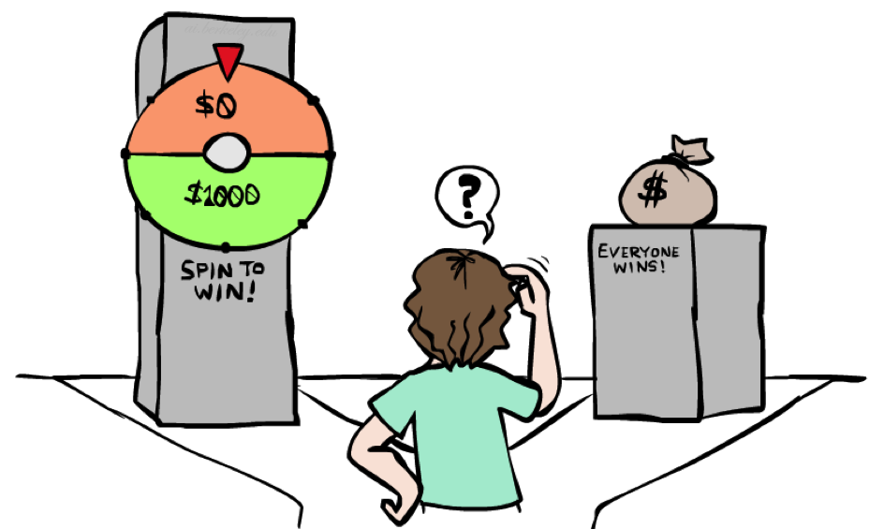
Example: Insurance
Consider the lottery [0.5, $1000; 0.5, $0]
What is its expected monetary value? ($500)
What is its certainty equivalent?
Monetary value acceptable in lieu of lottery
$400 for most people
Difference of $100 is the insurance premium
There’s an insurance industry because people will pay to reduce their risk
If everyone were risk-neutral, no insurance needed!
It’s win-win: you’d rather have the $400 and the insurance company would rather have the lottery (their utility curve is flat and they have many lotteries)

Slide 54

Example: Human Rationality?
Famous example of Allais (1953)
A: [0.8, $4k; 0.2, $0]
B: [1.0, $3k; 0.0, $0]
C: [0.2, $4k; 0.8, $0]
D: [0.25, $3k; 0.75, $0]
Most people prefer B > A, C > D
But if U($0) = 0, then
B > A ⇒ U($3k) > 0.8 U($4k)
C > D ⇒ 0.8 U($4k) > U($3k)

Slide 55
Next Time: MDPs!

Slide 56
What are Probabilities?
Objectivist / frequentist answer:
Averages over repeated experiments
E.g. empirically estimating P(rain) from historical observation
Assertion about how future experiments will go (in the limit)
New evidence changes the reference class
Makes one think of inherently random events, like rolling dice
Subjectivist / Bayesian answer:
Degrees of belief about unobserved variables
E.g. an agent’s belief that it’s raining, given the temperature
E.g. pacman’s belief that the ghost will turn left, given the state
Often learn probabilities from past experiences (more later)
New evidence updates beliefs (more later)

Slide 57
Uncertainty Everywhere
Not just for games of chance!
I’m sick: will I sneeze this minute?
Email contains “FREE!”: is it spam?
Tooth hurts: have cavity?
60 min enough to get to the airport?
Robot rotated wheel three times, how far did it advance?
Safe to cross street? (Look both ways!)
Sources of uncertainty in random variables:
Inherently random process (dice, etc)
Insufficient or weak evidence
Ignorance of underlying processes
Unmodeled variables
The world’s just noisy – it doesn’t behave according to plan!
Compare to fuzzy logic, which has degrees of truth, rather than just degrees of belief

